Slide 1
The use of <use> & other SVG requirements for mobile app web views
March 14, 2019

Slide 2

Adina Halter
Sr. Product Manager & Technology Lead, Accessibility
Comcast NBCUniversal
Twitter: @haltersweb
GitHub: haltersweb.github.io/Accessibility/
@haltersweb

Slide 3
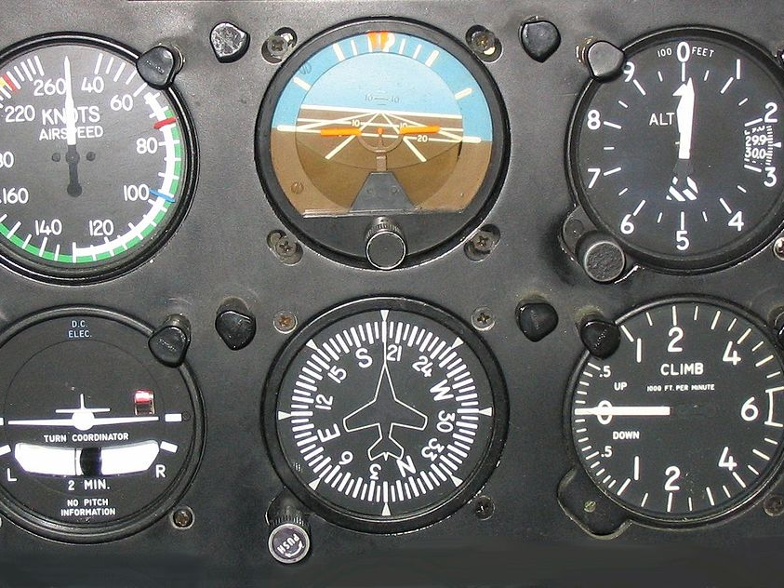
SVG usage
Six Flight Instruments. Meggar. CC BY-SA

Slide 4
most svg mobile web-view usage is for actionables
@haltersweb
Notes:
Actionable icons such as buttons, links

Slide 5
Yes
inline HTML
Meh
CSS .svg background image
<img> with .svg src
No
SVG page
@haltersweb
Notes:
Css background
needs accessible name
needs foreground alternative
<img> with .svg src : rules to abide by

Slide 6

SVG support
Website Code Html Coding Program. Lawrence Monk. CC
Notes:
Semantics will solve 90% of your problems

Slide 7
moving target!
@haltersweb
Notes:
Actionable icons such as buttons, links

Slide 8
No
<title>
<desc>
<svg role=“img”…>
<svg aria-label=“foo”…>
aria-labelledby, aria-describedby
@haltersweb
Notes:
title, desc
Not recognized on some
Double-read on some
svg role=img
not recognized or voiced by some *(recently fixed in iOS 12)
Aria-label
inconsistent in VO. Too many crazy convoluted rules to bother
Aria-labelledby, aria-describedby
repeating phrases by some

Slide 9
Yes
<svg role=“presentation”…>
<svg focusable=“false”…>
<button aria-label=“foo”><svg …>
Sibling with screen-reader-text
<svg aria-hidden=“true”…>
@haltersweb

Slide 10
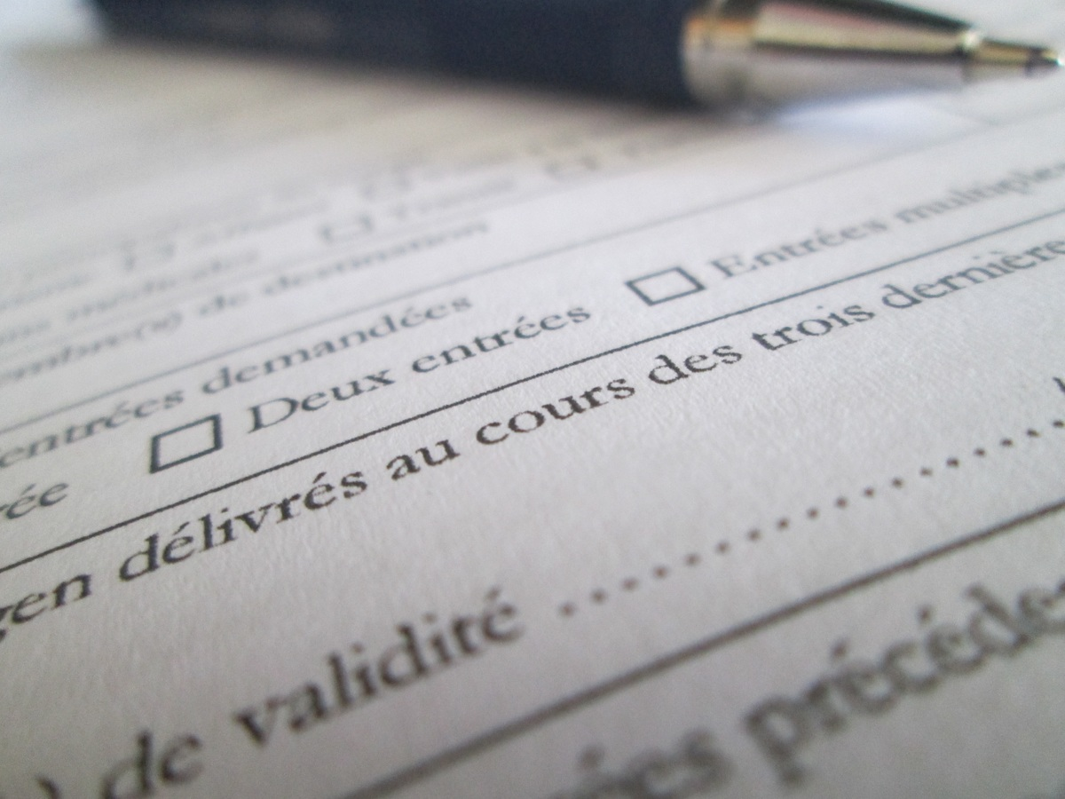
SVG in <img> src
Form. Anonymous. CC

Slide 11
Important
<img src=“foo.svg” alt=“yada yada” role=“img”…>
@haltersweb
Notes:
Forces VO to recognize it as an image and read the alt text.

Slide 12
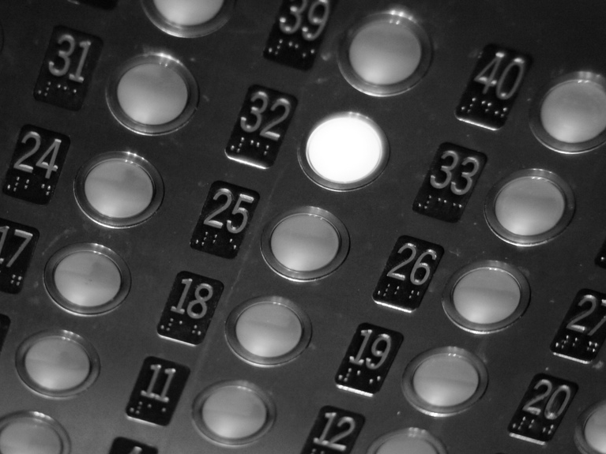
Button example
Elevator Buttons. Chad Kainz. CC BY

Slide 13
<button aria-label="Reveal navigation">
<svg … role="presentation" focusable="false" aria-hidden="true">
…
</svg>
</button>
@haltersweb

Slide 14
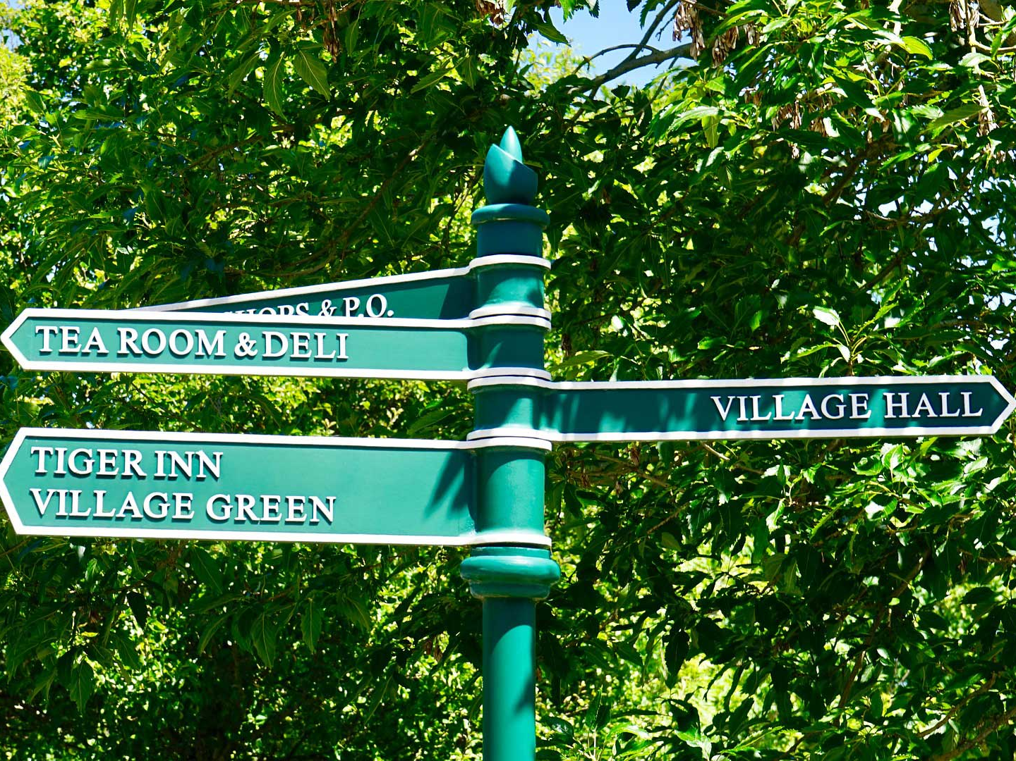
Link example
Sign Post Directions. MikesPhotos. CC

Slide 15
<a href= "http://www.google.com">
<span class=”screen-reader-text>change password</span>
<svg … role="presentation" focusable="false" aria-hidden="true">
…
</svg>
</a>
@haltersweb

Slide 16
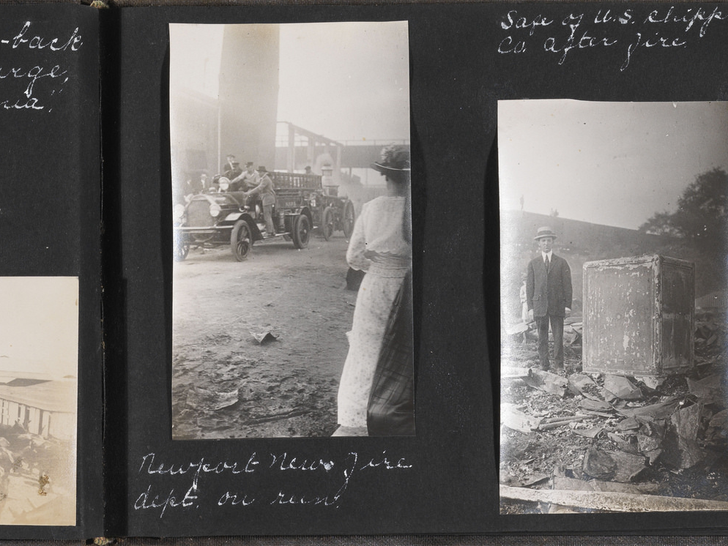
Image example
J. H. Breazeale Jr. Photograph Album: Mules of World War 1. The Library of Virginia. CC

Slide 17
<img src="foo.svg" alt="house" role="img">
@haltersweb

Slide 18
<button aria-label="Reveal navigation">
<img src="foo.svg" alt="" role=”presentation” aria-hidden=”true">
</button>
@haltersweb

Slide 19

<defs> and <use>
Woodtype. Free-Photos. CC

Slide 20
<defs>
A11y doesn’t get pulled through
@haltersweb
Notes:
Make sure to add a11y practices to cloned/reused element

Slide 21
<use>
Silence with:
aria-hidden = “true” on <use>, or
aria-hidden = “true” on parent
Safari focus bug:
Use whitespace between <svg> and <use>
@haltersweb
Notes:
<use> announces as <img> In some screen readers
(not aria-hidden = true on <svg> child of <use>)
Safari bug prevents focus from moving past <svg>

Slide 22
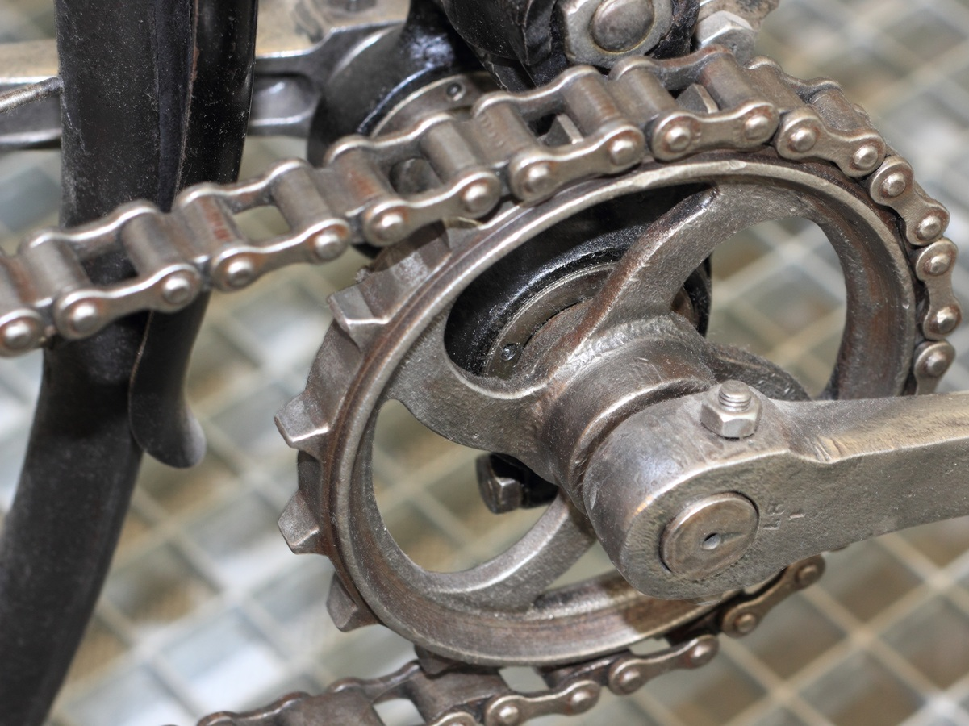
SVG animations
Bicycle Wheel. Anonymous. CC

Slide 23
Announce changes
@haltersweb
Notes:
i.e. status changes, resolves to something else

Slide 24

Zoom and pan
Book. Anonymous. CC

Slide 25
Keep piece in view
non-scaling stroke
@haltersweb
Notes:
Zoom and pan
Onzoom event
Use currentScale property to move piece back into view
Vector-effect to “non-scaling-stroke”

Slide 26
Color contrast
(enough said)
J. H. Breazeale Jr. Photograph Album: Mules of World War 1. The Library of Virginia. CC

Slide 27
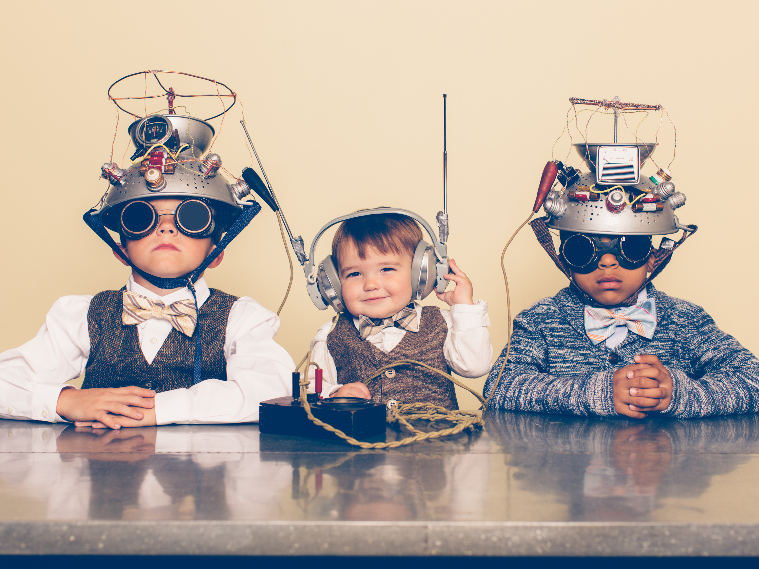
Future
Form. Anonymous. CC

Slide 28
SVG 2.0
SVG Accessibility API Mappings (AAM)
ARIA Graphics module
@haltersweb
Notes:
SVG 2.0 – stalled for a couple of years. Only picked up again feb 2018
AAM - in process (also stalled for awhile)
ARIA Graphics module: in process

Slide 29
Adina Halter
Sr. Product Manager & Chief Technologist, Accessibility
Comcast NBCUniversal
Twitter: @haltersweb
GitHub: haltersweb.github.io/Accessibility/
@haltersweb

